Slide 1

Unified Learning Management System
In-House Pilot Proposal: A single platform to build, deliver, and track technical and behavioral trainings organization-wide.

Slide 2
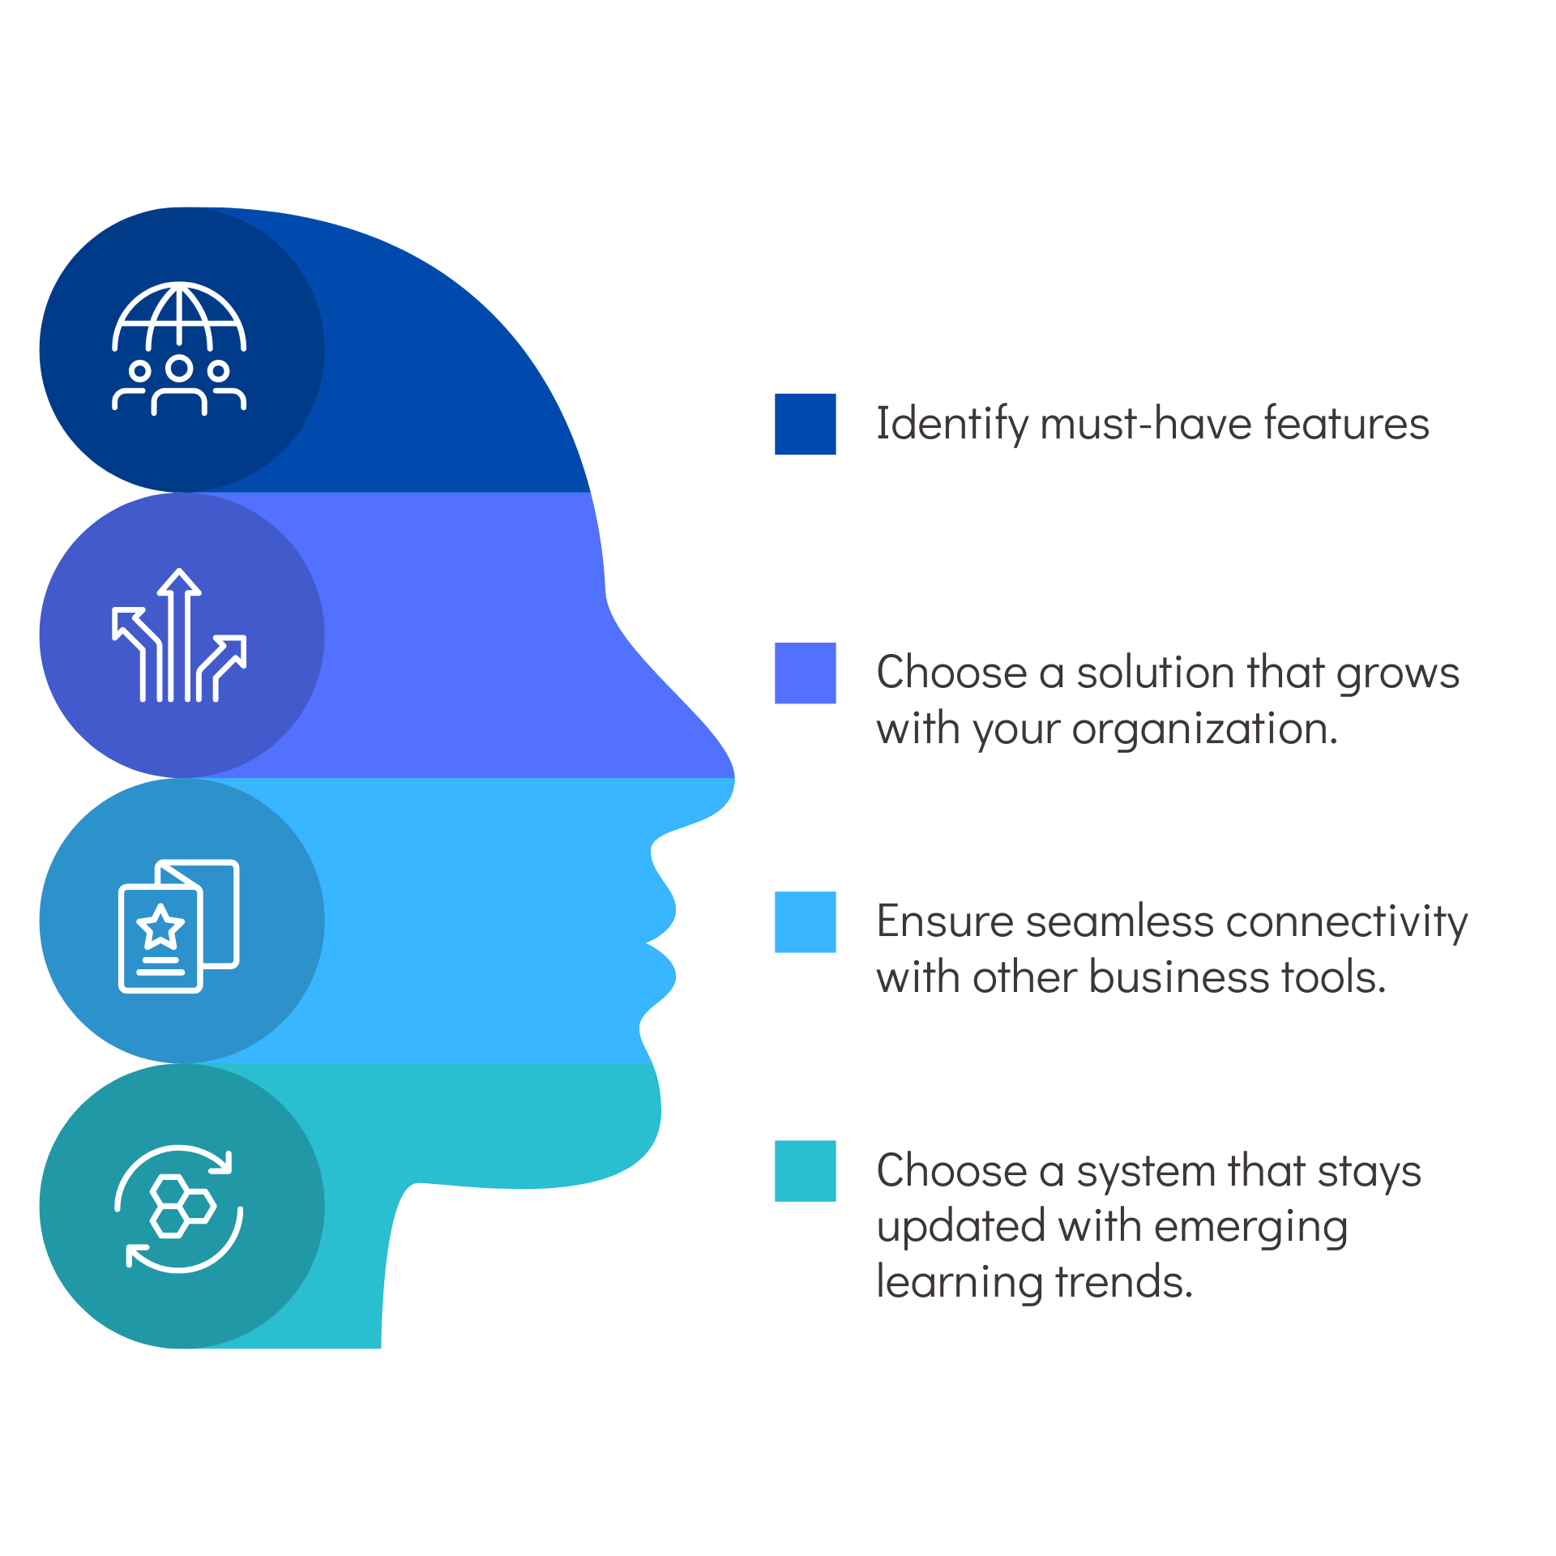
Strategic Background & Objective
A Single Platform for Organizational Learning
Currently, training records and compliance data are scattered. We propose a unified LMS to host, assign, and track all technical and behavioral training.
Crucially, every training will feature a built-in assessment, rather than a disconnected test. Progress will be completely transparent, visible to both the individual learner and their controlling officer.

Slide 3






Pilot Status: Objectives Achieved
Core Objectives Met
The Built Pilot (Ready for DC)
A single platform has been established where training for all executives can be hosted and tracked seamlessly.
Developed entirely in-house by Sh. Nitin Dua, CM (Prog.) with inputs from the Strategy Group.
It successfully integrates built-in assessments directly into the learning flow, eliminating disconnected external tests. Dual dashboard visibility ensures transparent tracking for both individuals and management.
The system features robust course authoring with auto-scored quizzes. It fully supports industry standard SCORM-based courses alongside video, PDF, and HTML. It is currently populated with dummy data and ready to be mounted on Data Centre infrastructure.

Slide 4
Pilot Status: Objectives Achieved
IN-HOUSE DEVELOPMENT
KEY SYSTEM CAPABILITIES
A standalone pilot LMS has already been developed entirely in-house by Sh. Nitin Dua, CM (Prog.), utilizing strategic inputs from the Strategy Group.
Content Engine: Supports SCORM-based courses, alongside standard video, PDF, HTML and image-based content.
The system is currently populated with dummy data for testing and is fully prepared to be mounted on our secure Data Centre infrastructure.
Trainings for all executives can be hosted and tracked seamlessly.
Assessment: Built-in course authoring with section-level quizzes and automatic scoring.
Visibility: Dual working dashboards explicitly designed for the individual learner and the controlling officer.

Slide 5
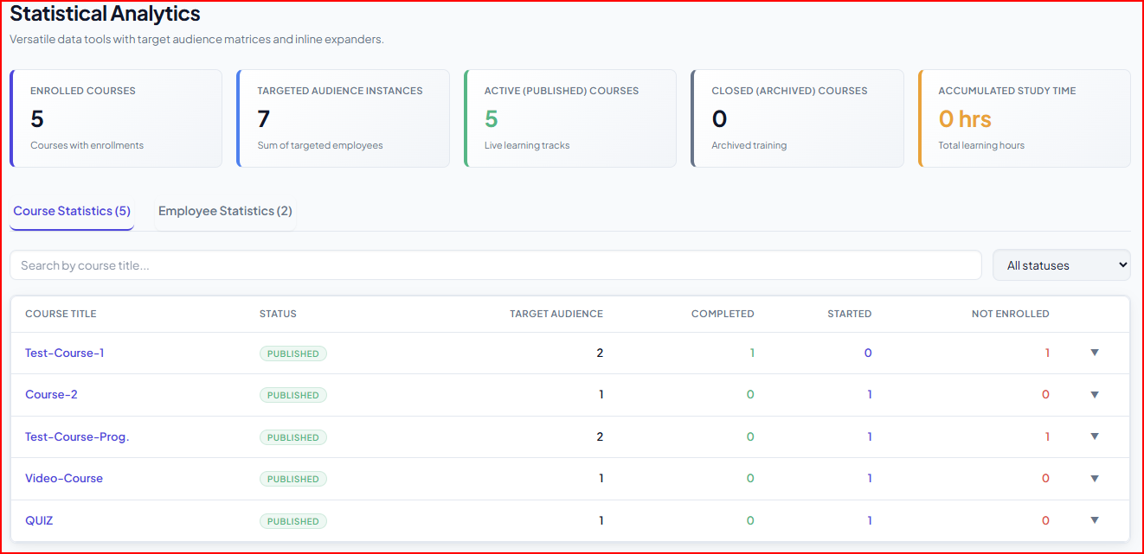
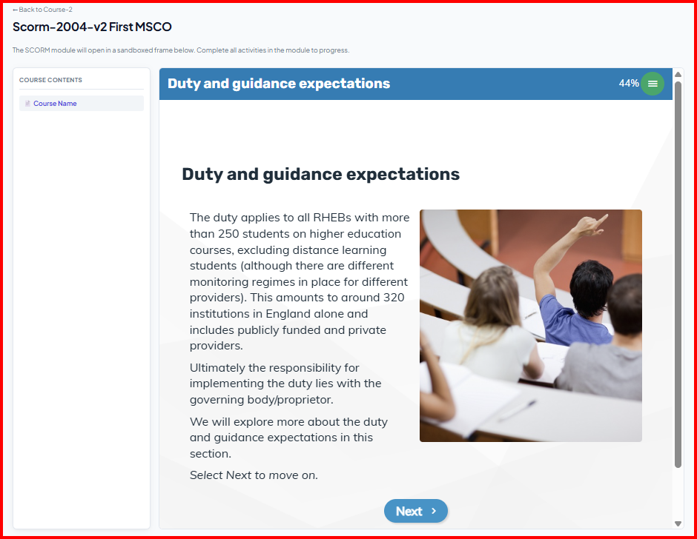
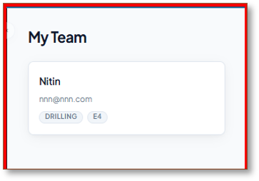
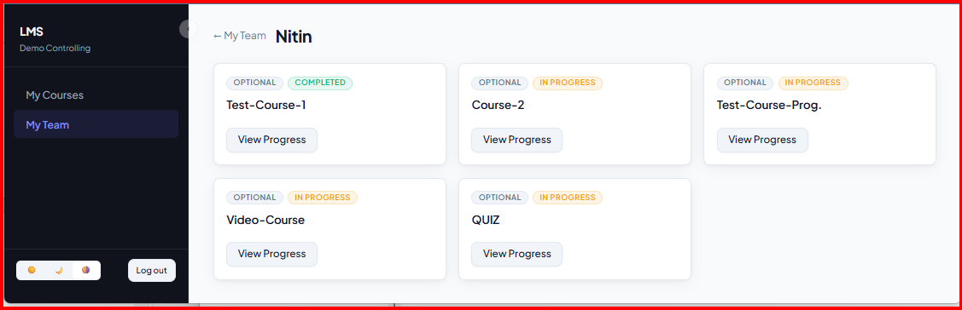
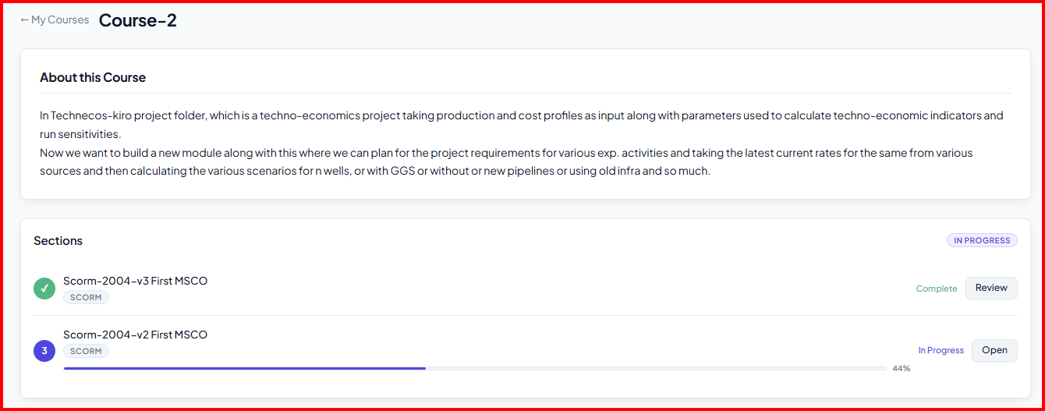
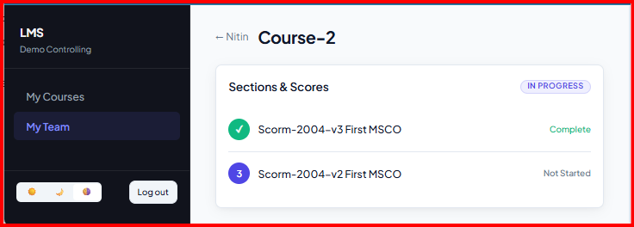
The Pilot System in Action
Statistical Analytics
Course & SCORM Player
Controlling Officer View
Overall enrollment, audience targeting, and accumulated study time metrics.
Individual learner view displaying course sections, activities, and integrated assessments.
A dedicated dashboard to monitor team compliance and individual direct report progress.

Slide 6

Execution Committee Formation
Member Name | Designation / Group | Role in Committee
Sh. Ajay Sahoo | HOI-ONGC Academy | Team Lead (Coordination with all training imparting institutes)
Sh. Mahesh Kumar | CGM (HR), ICE-HR Team lead | Team Lead for SAP Integration
Sh. Nikhil Dahat | GM (IE), Strategy Group | Member
Sh. Chunuram Hembram | GM (E&T), Data Centre Grp - Corp. Infocom | Member
Sh. Satyajit Das | GM (Programming), Corporate Infocom | Member
Sh. Nitin Dua | CM (Programming), Database Group-Vadodara | Member (Developed LMS Pilot)
Sh. Anshul Tiwari | CE (P), Strategy Group | Member

Slide 7
Committee Responsibilities & Parallel Activities
Validation & Infrastructure Setup Validate the developed pilot. Provide on-premises IT resources and infrastructure for securely mounting the LMS.
Content Integration & Functionality Check Upload content provided by ONGCA and ATI-GOA. Ensure all functionalities—content delivery, assessments, and GAP analysis—run successfully.
Org-Wide Rollout & Ongoing Maintenance Lead the organization-wide rollout. Post-implementation, ONGC Academy is responsible for day-to-day maintenance and troubleshooting.
GT Training & Mandatory Course Identification ONGC Academy will upload GT training material in LMS format for E1-E5 executives and identify mandatory/desirable courses by interacting with SMEs.

Slide 8





Parallel Activity: Targeted Content Strategy
Technical Content (E1 to E5)
Behavioral Content (E6, L1-L3)
ONGCA and ATI GOA will interact with SMEs to finalize the list of technical trainings for each discipline.
For senior roles, ONGCA and ATI GOA will curate specialized Managerial and Behavioral courses.
They will curate these targeted training courses alongside built-in assessments for E1 to E5 level executives and provide the complete content to the Execution Committee for upload.
Crucially, these courses will feature assessments explicitly designed around the six behavioural competencies currently assessed through ADCs. The Execution Committee will upload and integrate these with the institutes' collaboration.

Slide 9


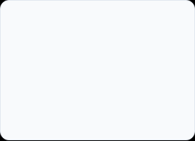
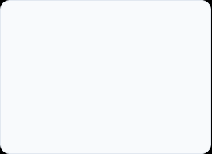
The Basic Operational Flow
2. Upload & Quiz
4. Update & Sync
Committee uploads content to the LMS. A quiz is attached to each section.
Dashboards update for learner and controlling officer; data syncs to SAP.
1. Provide Content
3. Complete & Score
ONGCA & ATI GOA provide curated training content to the Execution Committee.
Learner completes the section and quiz. Score is recorded automatically.

Slide 10







The Business Case: Why In-House?
Zero Licensing Costs
Total Data Sovereignty
Content Freedom
Unlike commercial purchased products, our custom solution incurs no initial purchasing cost and zero recurring, per-employee licensing fees.
We maintain full control over organizational knowledge.
Everything stays secure inside our own corporate Data Centre, rather than a third-party cloud.
We are completely free to support any content type or assessment format our institutes require, rather than being strictly limited to what a vendor permits.

Slide 11








Basic Requirements for the Testing Stage
IT Infrastructure
Test Group
Sample Content
A modest server/VM allocation from the Data Centre to mount the pilot. One or two hosts with approximately 500 GB of storage will be sufficient initially.
Access granted for approximately 10 cross-functional users for the next phase of validation testing, ensuring appropriate hardware compatibility.
A short, controlled list of test content—such as a few freely available training videos and PDFs—to run through the system's logic and assessment flow.

Slide 12
Staged Implementation Plan
Stage | Action & Objective | Target Timeline
Stage 1 | Validate existing pilot on Data Centre hardware and testing with dummy data. | Within 15 days of resources
Stage 2 | Open system to ~10 users with real test content on better infrastructure. Validate dashboard, reporting, and manager views. | Post-Stage 1
Stage 4 | ONGCA and ATI Goa to curate comprehensive courses for uploading into the LMS. | Parallel Activity
Stage 5 | Scale the tested platform capacity to the full organization. | Strategic Go-Live
Stage 6 | Make the system fully device agnostic (accessible from laptop, tablet, and mobile). | Post-Launch

Slide 13

We seek approval to test the prototype on a small scale, then scale it for organization-wide usage.
Responsibility: ONGC Academy to monitor stability and once fully operational, maintain and upgrade as required.
Thank You.

